Slide 1
Data Analysis Project 2023
Topic 01
Group 04
Ole Decker, Heinrike Gilles, Bastian Mucha, Anastasia Warken
Notes:
Nasty
Begrüßung: Data Analysis project Fashion recognition

Slide 2
Overview
Dataset
Project Parts
Evaluation methods
Additional objectives
Timeline
Notes:
Nasty
Dataset and project parts: Me
PCA and KNN: Ole
Eval Methods: Heini
Add obj: Basti
Timeline: Heini

Slide 3
Fashion MNIST dataset
Dataset Project parts Evaluation methods Additional objectives Timeline
MNIST: Modified National Institute of Standards and Technology database
Training set 60.000 images
Test set 10.000 images
28 x 28 pixels grayscale
10 different classes (noted in first column)
CSV files (Comma-separated values)
Size-normalized & centered (visually)
each row is one image with values from 0 to 255
Notes:
Nasty
MNIST: Modified National Institute of Standards and Technology database
Zalando's article images
Tranining set and test set
28 x 28 pixels grayscale with 10 dif classes
Classes: Coat, Shirt, Dress, Bag, T-Shirt, Pullover, Sandal, Sneaker, Trouser, Ankle Boot
First column: Class, all other columns: Intensities separated by a comma (CSV)
Grayscale image with intensity value between 0 and 255
All images have the same size and the item is centered on picture
Used for benchmarking machine learning alhorithms

Slide 4
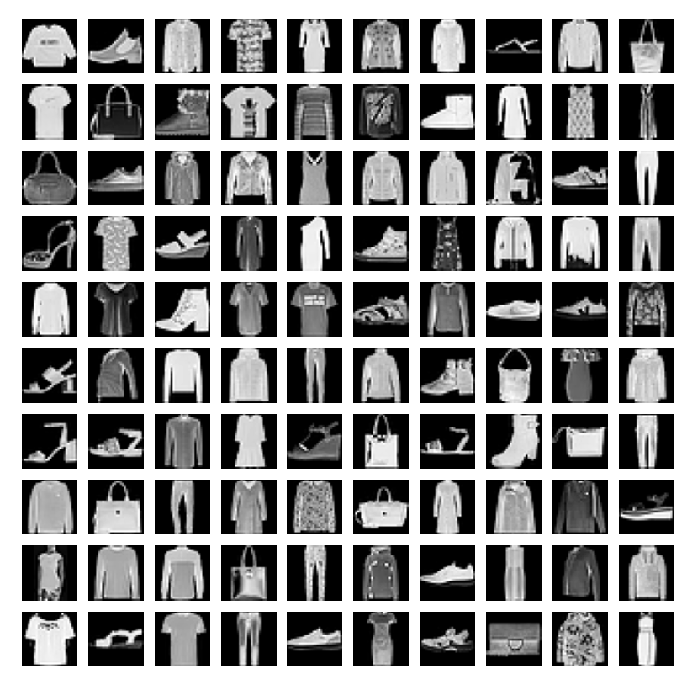
Dataset Project parts Evaluation methods Additional objectives Timeline
Notes:
Nasty
MNIST: Modified National Institute of Standards and Technology database
Zalando's article images
Tranining set and test set
28 x 28 pixels grayscale with 10 dif classes
Classes: Coat, Shirt, Dress, Bag, T-Shirt, Pullover, Sandal, Sneaker, Trouser, Ankle Boot
First column: Class, all other columns: Intensities separated by a comma (CSV)
Grayscale image with intensity value between 0 and 255
All images have the same size and the item is centered on picture
Used for benchmarking machine learning alhorithms

Slide 5

Expected difficulties
Dataset Project parts Evaluation methods Additional objectives Timeline
textures not recognized by KNN
shapes complex & similar across classes
high variance within classes
<a href="https://www.flaticon.com/free-icons/difficult" title="difficult icons">Difficult icons created by bsd - Flaticon</a>
Notes:
Nasty
KNN does not recognize textures and patterns
Within class relatively high variance (example: Class bag, bags with patterns, shoulder bags, clutches etc.)
Between classes shapes can be very similar (example: Classes shirt and T-shirt)
In general: Shapes can be very complex compared to handwritten digits, who share a similarity and have clear distinctions

Slide 6
Process
Dataset Project parts Evaluation methods Additional objectives Timeline
Centering and Scaling
PCA
KNN
Notes:
Nasty
General process of implementing K nearest neighbors
Centering and Scaling the dataset
Performing a principal component analysis
Performing KNN

Slide 7
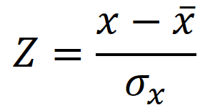
Z-transformation
Dataset Project parts Evaluation methods Additional objectives Timeline
Preparation of the dataset
centering & scaling
Removal of values with σ = 0
Notes:
Nasty
Operation of centering and scaling is called a Z-Transformation
Prepare dataset for KNN
Center data by subtracting mean
Scale data by dividing by standard deviation
Challenge: Standard deviation may not be 0, there might be pixels where across the entire dataset the intensity is 0 (outermost edges). Remove these pixels so that we do not divide by 0.

Slide 8

PCA: Principal Component Analysis
Dataset Project parts Evaluation methods Additional objectives Timeline
Rotating data matrix → fewer dimensions explain a lot of variance
Speeds up KNN: Reduction of dimensions while retaining most information
Avoids overfitting during KNN
Using Eigenvalues and Eigenmatrix
PCs have no correlation to each other
Notes:
Ole
Goal: compact representation of the data while minimizing information loss.
how: Reducing amount of variables in a large dataset
how: rotating data matrix through multiplying with Eigenmatrix
how: Eigenmatrix consists of previously calculated Eigenvectors
overfitting = funk. gut für traindata aber schlecht für testdata, weil spezialisiert.
lambda

Slide 9
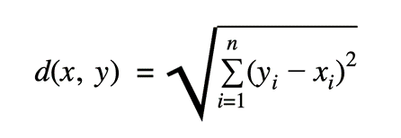
KNN: K nearest neighbor
Dataset Project parts Evaluation methods Additional objectives Timeline
Take one test point
Choose value of k
Calculate Euclidean distances to all training points
Select k training points with smallest distance
Determine majority class of k nearest neighbors
Assign predicted class
Repeat for each data point
Notes:
Ole
assign labels to pics
training - distance to all test img.

Slide 10
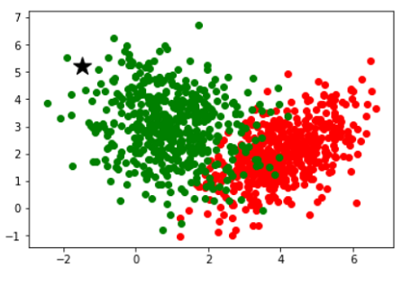
KNN: K nearest neighbor
Dataset Project parts Evaluation methods Additional objectives Timeline
non-parametric, supervised learning classifier
https://www.analyticssteps.com/blogs/how-does-k-nearest-neighbor-works-machine-learning-classification-problem
Notes:
Ole
Non-parametric means there is no assumption for underlying data distribution

Slide 11
Evaluation methods
Dataset Project parts Evaluation methods Additional objectives Timeline
Assessment of performance and effectiveness of the algorithm
Accuracy
measures overall correctness of classification
Confusion Matrix
predicted class labels against the true class labels of a dataset
correct predictions
all predictions
Predicted class
 | 1 | 2 | 3
1 | C11 | C12 | C13
2 | C21 | C22 | C23
3 | C31 | C32 | C33
Actual class
Notes:
Heini
- To determine how well the algorithm is making predictions, how well it’s working
- Accuracy: overall measure of how well the model is performing; formula
- Confusion Matrix: to examine what type of errors are typically made (eg. are shirts often classified as dresses?)
example table with 3 classes, predicted class vs actual class;
(diagonal is correctly classified)
gives per-class precision & per-class recall
(Per-Class Precision: precision of each class
The proportion of true positive predictions for a specific class (Cii) over the sum of true positive and false positive predictions for that class.
Per-Class Recall: proportion of positive instances that are correctly identified by a model. It focuses on the ability of a model to find all positive instances from the total number of actual positive instances in the dataset.
The proportion of true positive predictions for a specific class (Cii) over the sum of true positive and false negative predictions for that class.)
(accuracy =/= precision)
Precision = (Number of True Positives) / (Number of True Positives + Number of False Positives)
Precision is better if the goal is to have highly accurate and precise predictions for specific categories

Slide 12
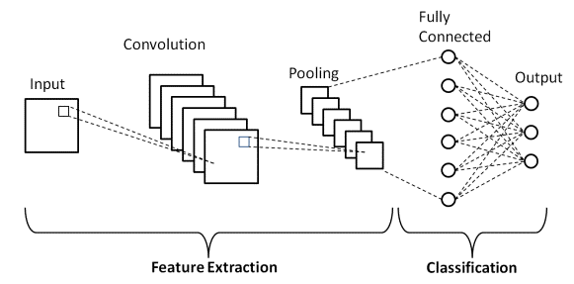
CNN: Convolutional Neural Network
Dataset Project parts Evaluation methods Additional objectives Timeline
deep learning model for image and video processing
multiple layers
convolutional layers
pooling layers
fully-connected (FC) layers
Basic CNN Architecture: Explaining 5 Layers of Convolutional Neural Network | upGrad blog
Notes:
To understand how CNNs work, we first have to look at normal neural networks: In normal neural networks, there are neuron layers which are connected with each other. The strength of these connections is trainable. For images, however, this doesn`t work that well, because detecting features like edges or textures is difficult. This is what convolution, which you might remember from last semester, does. In CNNs, the convolution mask itself is trainable. Another important part are pooling layers, which reduce dimension to avoid overfitting. Lastly, there are normal neural layers which do the actual classification using the convolution results.

Slide 13
CNN vs. KNN
Dataset Project parts Evaluation methods Additional objectives Timeline
local features are recognized e.g. edges, corners, textures
slow learning, fast classification
easier implementation and easier to understand
no learning phase, slow classification
Notes:
Basti
multiple layers: convolutional layers, pooling layers, and fully connected layers

Slide 14
Timeline & division of tasks
Dataset Project parts Evaluation methods Additional objectives Timeline
Defining project objectives
Report
Project Proposal
CNN
Final Presentation
KNN
Evaluation methods
Centering & PCA
Notes:
Heini
Dark: already done
Yellow: To Do
Defining project objectives
Centering & PCA: Basti & Nasty → review: Ole & Heini
KNN: Ole → review: Basti & Heini
CNN: Basti & Ole → review:Heini & Nasty
Evaluation methods: Nasty & Heini → review: Ole & Basti
Report → split evenly

Slide 15
Thank you for your attention!
Questions?

Slide 16
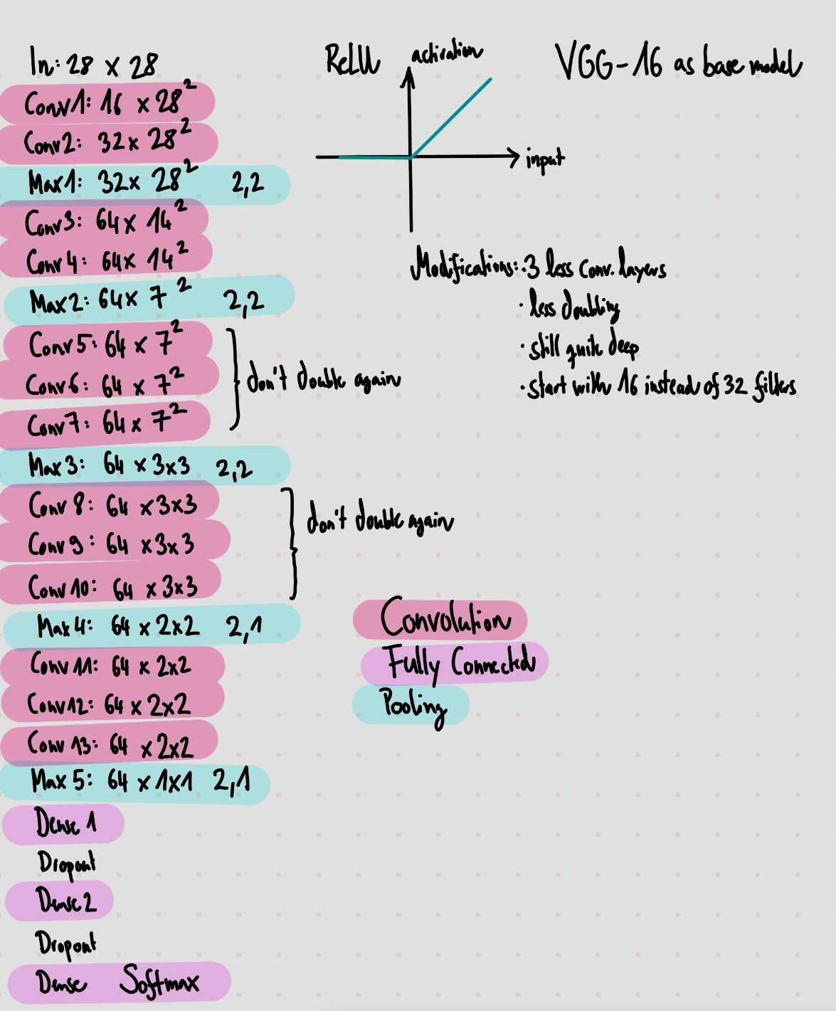
CNN Architecture
Dataset Project parts Evaluation methods Additional objectives Timeline
deep but simple VGG-16 as base model
Rectifier Linear Unit (ReLU) as activation
Max Pooling
Modifications:
convolution layers with less feature maps
less convolution layers

